Slide 1



Part 2
By: Omer Ben-Naim, Maya Saghiv

Slide 2

Agenda
Descriptive Statistics
Model Selection & Performance Evaluation
Collaborative Filtering
Content Filtering
Model Limitations & Mitigations
Conclusions
Recommendations for Future Work
Notes:
Project overview:
Project description
Project goal
Dataset overview:
Background
Datasets show – printscreen of 3 datasets – data, user, movies
Plan of attack:
Preperation & preprocessing
Descriptive statistics (users, movies & rates)
Methods – collaborative, content
Models - ….
Performance measures
*challenges

Slide 3
Reminders (from Part 1)
Notes:
OMER

Slide 4
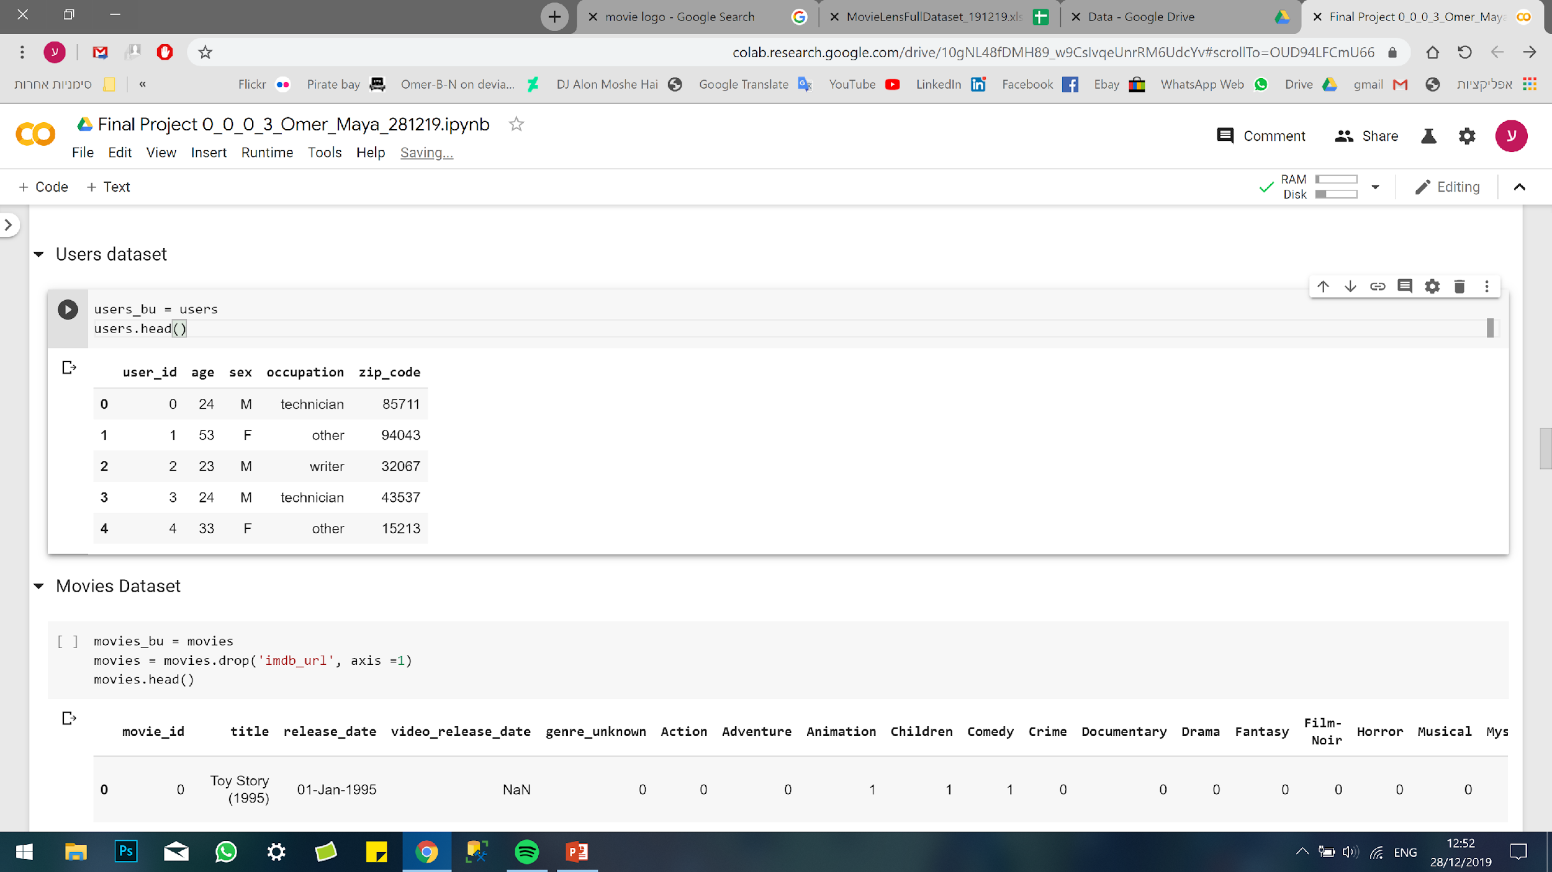
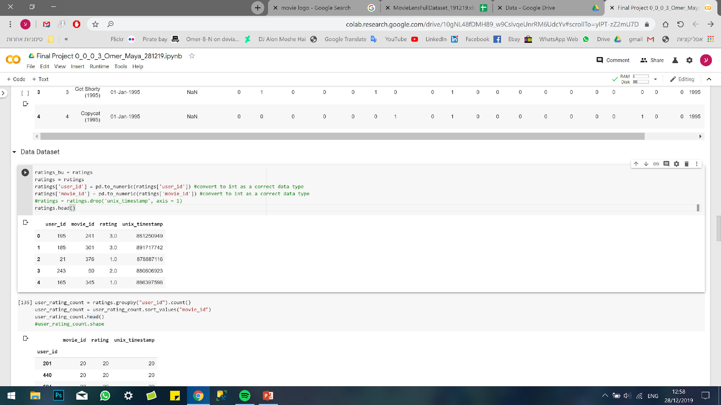
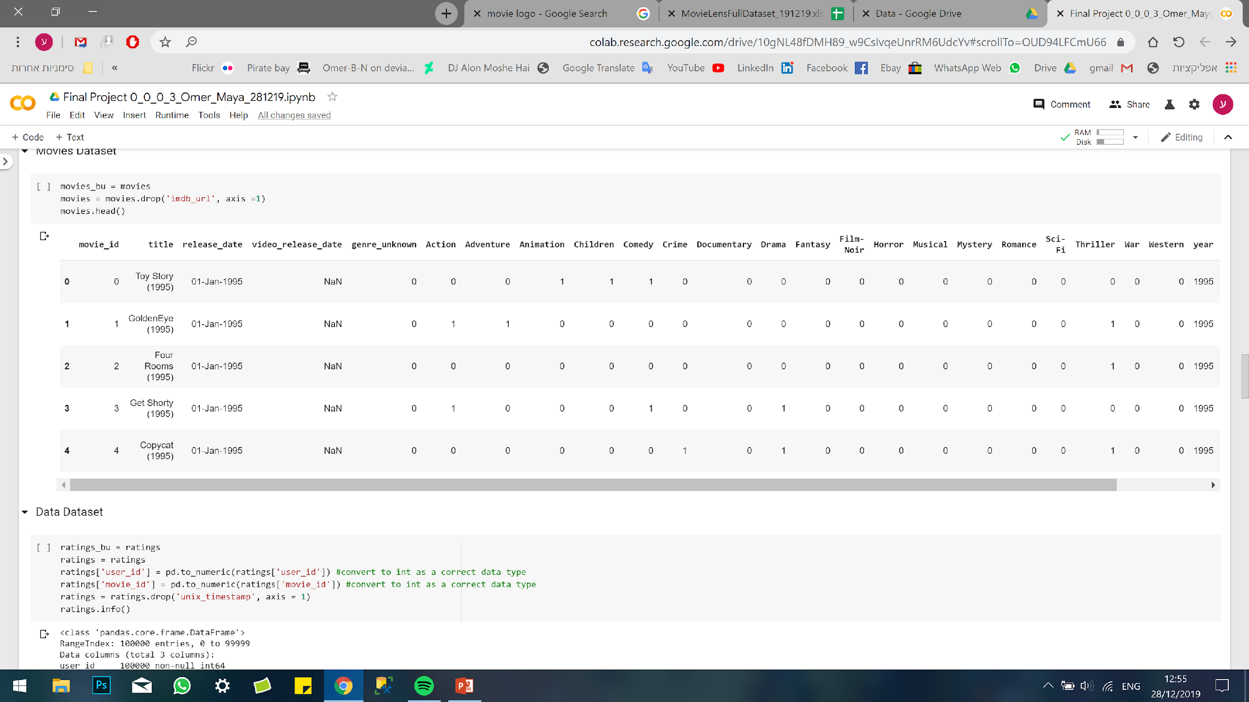
Overview – Datasets
REMINDER
3 sets of the Database:
Users:
Ratings:
943
100,000
Movies:
1,682
Notes:
OMER

Slide 5


Overview – Goal
REMINDER
Classifying the problem:
Recommendation system
Goal:
Recommend the 10 most relevant movies to each user
Notes:
OMER

Slide 6
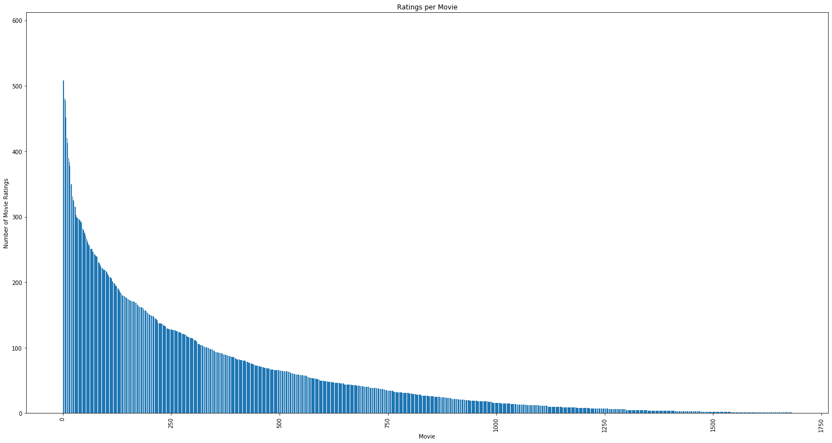
Preparation and preprocessing Extracting ‘Valuable Data’
Ratings per Movie – ‘Valuable Data’ Baseline
Ratings
REMINDER
Movies with Ratings 5 and above:
80.2% of the Movies
100% of the Users
99.3% of the Ratings
5
Movies
Notes:
MAYA

Slide 7
Descriptive Statistics
‘Valuable’ Data’ EDA
Notes:
OMER

Slide 8
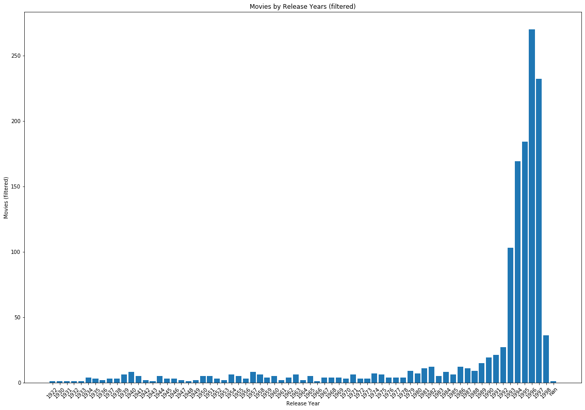
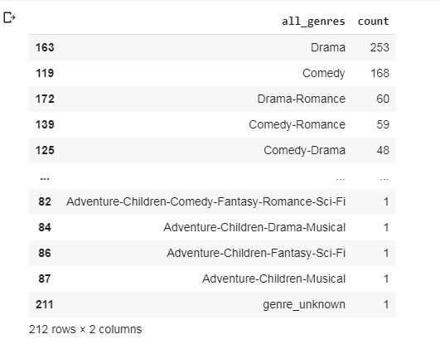
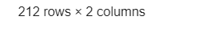
Descriptive Statistics (1) ‘Movies’ Exploratory ‘Valuable Data’ Analysis
Movies (80.2%)
Movies by Release Years
Movies by Genre
Movie
1993
1998
5
Release Year

Slide 9
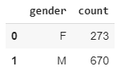
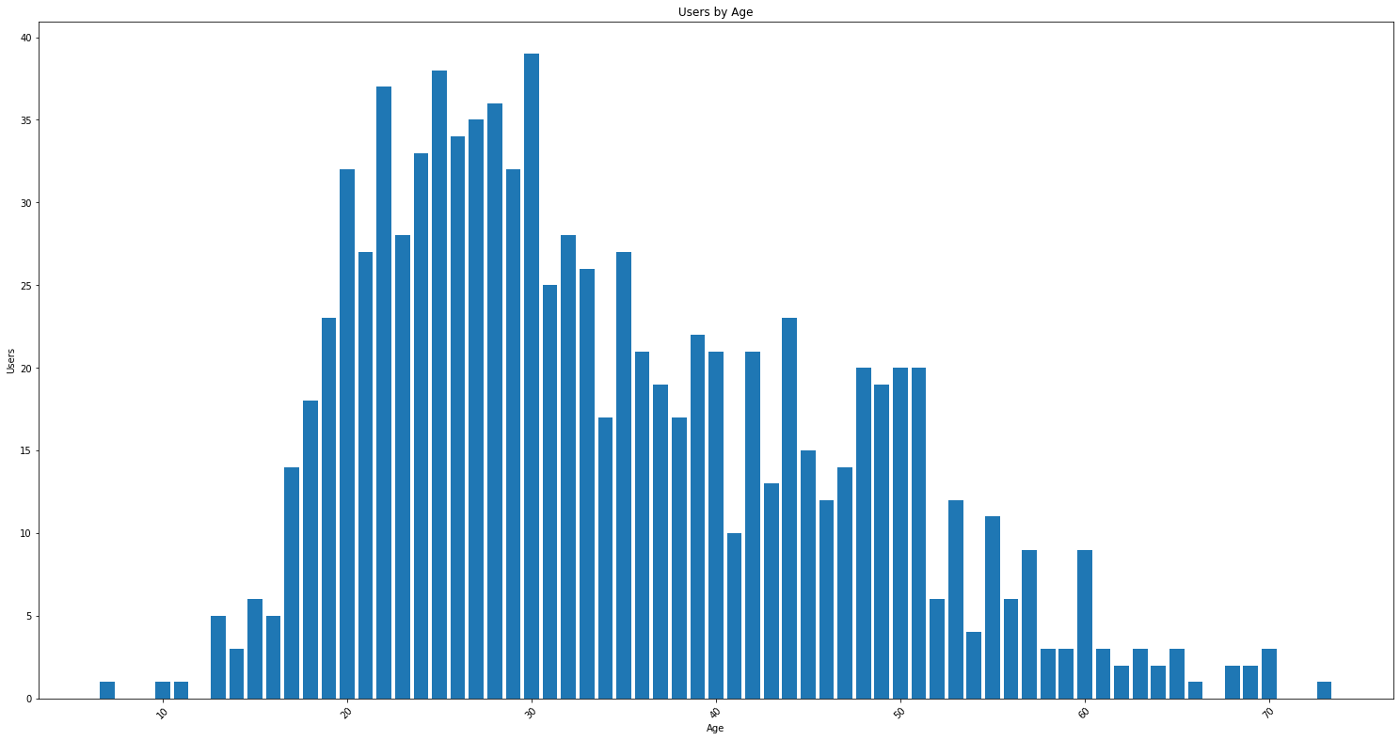
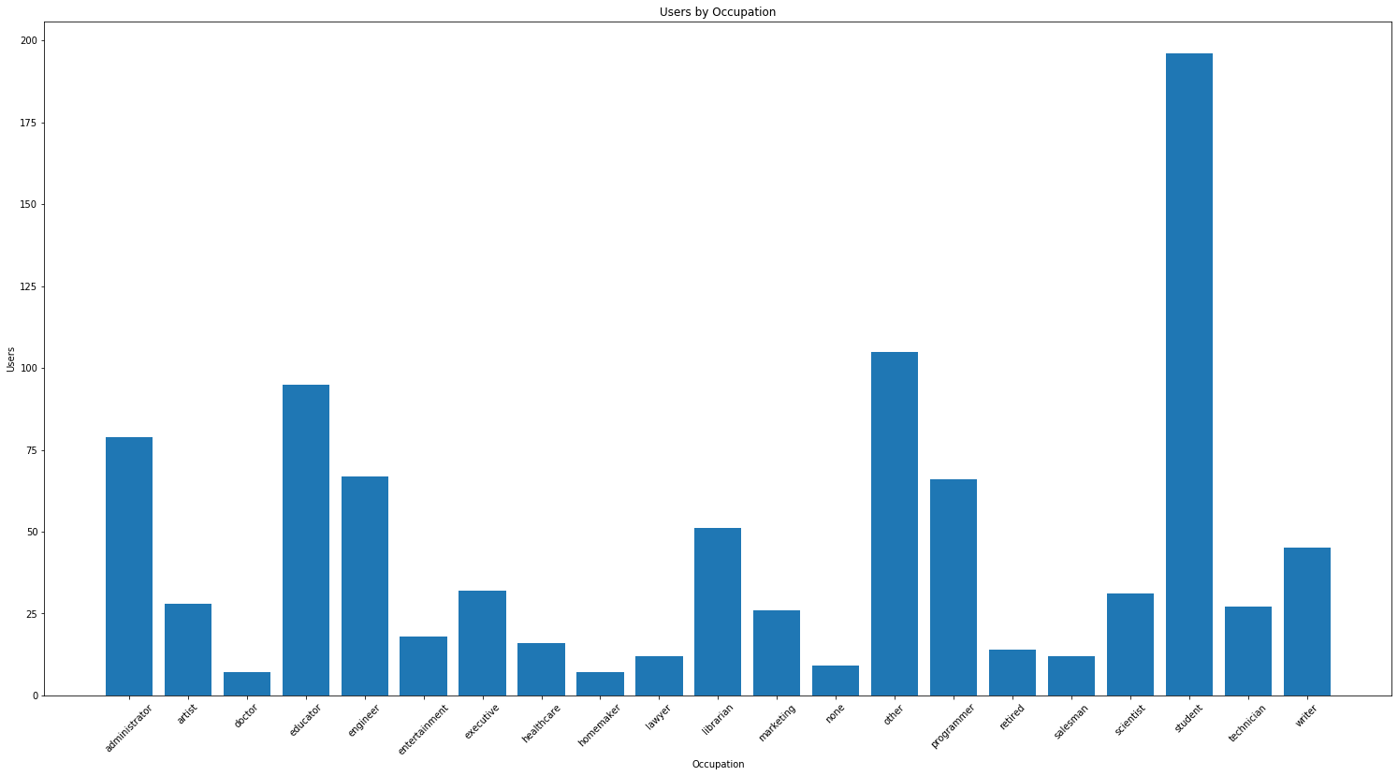
Descriptive Statistics (2) ‘Users’ Exploratory ‘Valuable Data’ Analysis
Users (100%)
Users by Gender
Users by Age
Users by Occupation
Student
I
35
51
17
II
60
Other
Educator
III
Administrator
Engineer
Programmer
Librarian
50

Slide 10
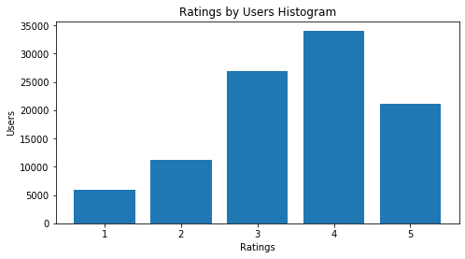
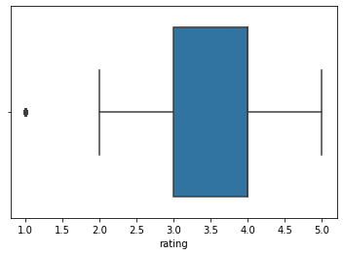
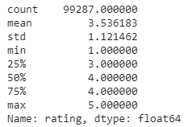
Descriptive Statistics (3) ‘Ratings’ Exploratory ‘Valuable Data’ Analysis
Ratings (99.3%)
Ratings Histogram
Ratings Boxplot
Ratings Describe
34,035
26,963
21,130
11,259
5,900

Slide 11
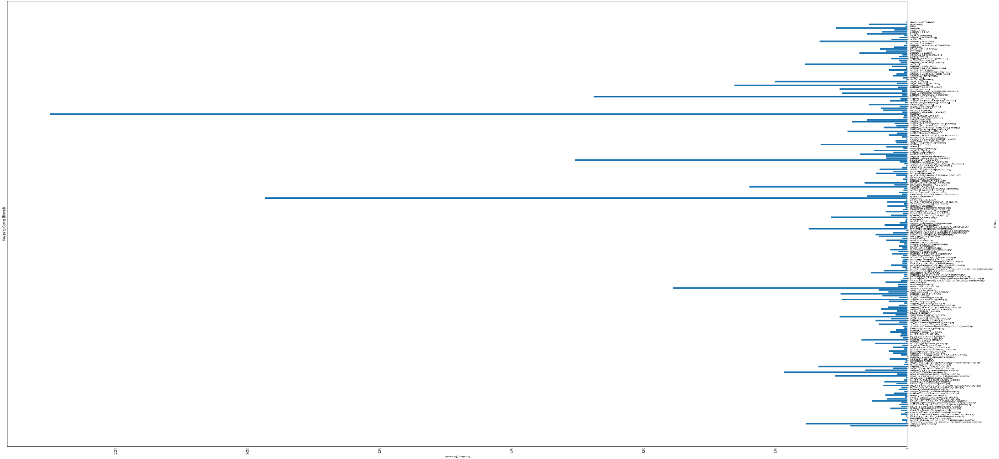
Descriptive Statistics (4) ‘Ratings’ Exploratory ‘Valuable Data’ Analysis
Ratings (99.3%) (cont’d)
Ratings per Genre
Drama-Romance
Drama-Thriller
Drama
Comedy-Romance
Comedy
Comedy-Drama
Action-Thriller

Slide 12
Models Selection & Evaluation
Notes:
OMER

Slide 13
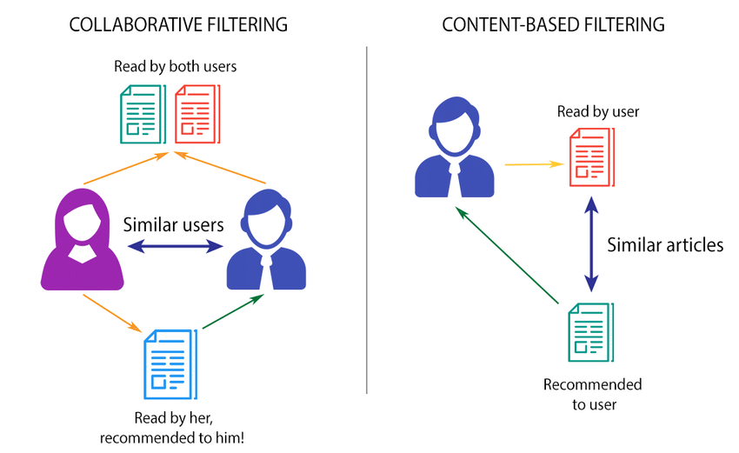

Recommendation System Model Selection & Evaluation
Recommender Systems
Collaborative
(user-based)
Demographic
Content-Based
(item-based)

Slide 14
Collaborative Filtering
Notes:
OMER

Slide 15
Collaborative Filtering Model Selection & Evaluation (1)
Datasets (Ratings Threshold, % of Movies)
{(R>=1, 100%); (R>=5, 80.2%); (R>=20, 55.8% ); (R>=50, 35.9%); R>=100, 20.1%)}
Model Selection (Python ‘surprise’)
KNNBaseline, KNNWithMeans, KNNZScore, KNNBasic;
BaselineOnly, NormalPredictor;
NMF, SVD;
SlopeOne, CoClustering
Hyper-Parameter Tuning (Cross Validation K=5, K=10)
Performance Measures (RMSE, MAE)
Total Runs: 100
Total Performance Measures: 200 Best Model (for ALL datasets):
KNN Baseline
CV K=10

Slide 16
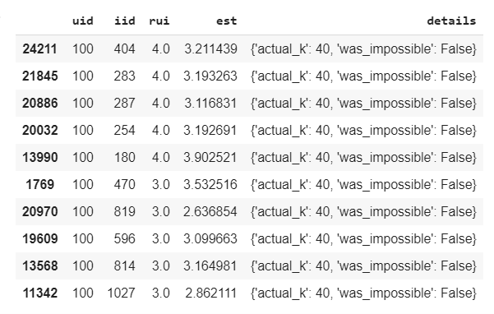
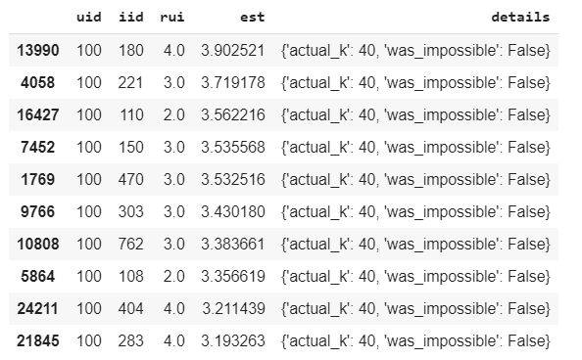
Hit Rate (user_id=100)
Hit Rate: 0.4
Top 10 / Descending Order by ‘rui’
Top 10 / Descending Order by ‘est’

Slide 17
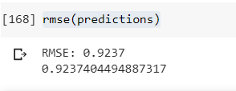
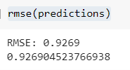
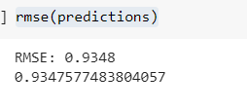
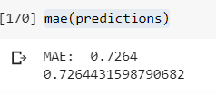
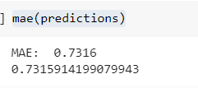
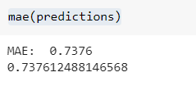
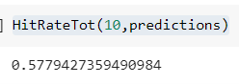
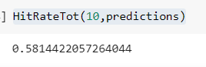
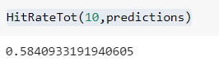
KNNBaseline | CV=10 Train (70%) / Test (30%)
Run #1:
Rating >=50, 35.9% Movies
Run #2:
Rating >=20, 55.8% Movies
Run #3:
Rating >=5, 80.2% Movies

Slide 18
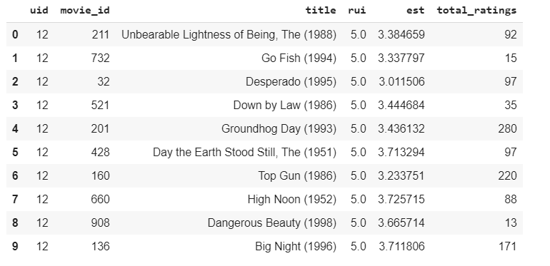
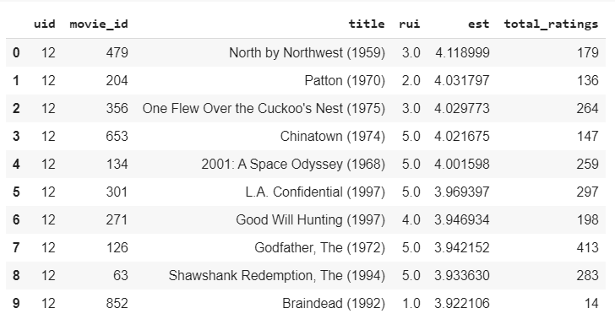
Collaborative Filtering Test Case |user_id=12 (51 movie ratings) Ratings Threshold >=5 Users: 100% | Movies: 80.2% | Ratings: 99.3%
Hit Rate: 0.0
Ascending actual
Ascending Predicted
<=100
<=50

Slide 19
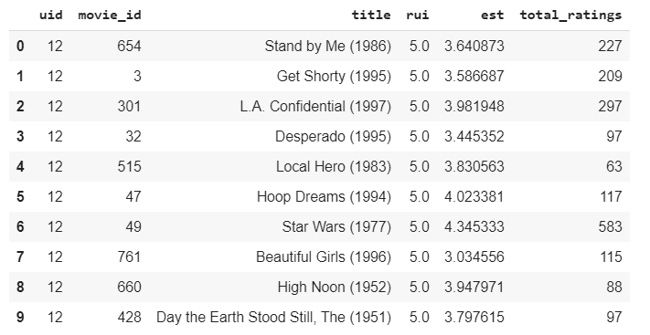
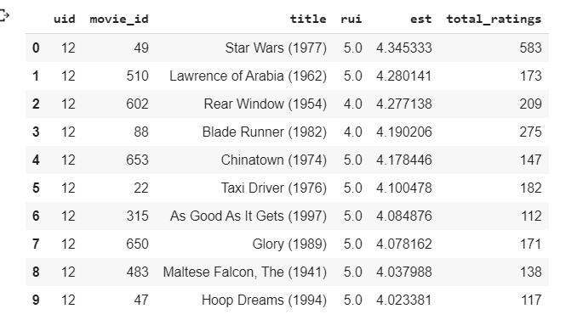
Collaborative Filtering Test Case | user_id=100 Ratings Threshold >=50 Users: 100% | Movies: 35.9% | Ratings: 83.7%
Hit Rate: 0.2
Ascending actual
Ascending Predicted

Slide 20
Collaborative Filtering Test Case | user_id=100 Predicted- Ratings Threshold >=5 vs. Ratings Threshold >=50
Ascending Predicted, Rating Threshold>=50
Ascending Predicted, Rating Threshold>=5

Slide 21
Content-Based Filtering
Notes:
OMER

Slide 22
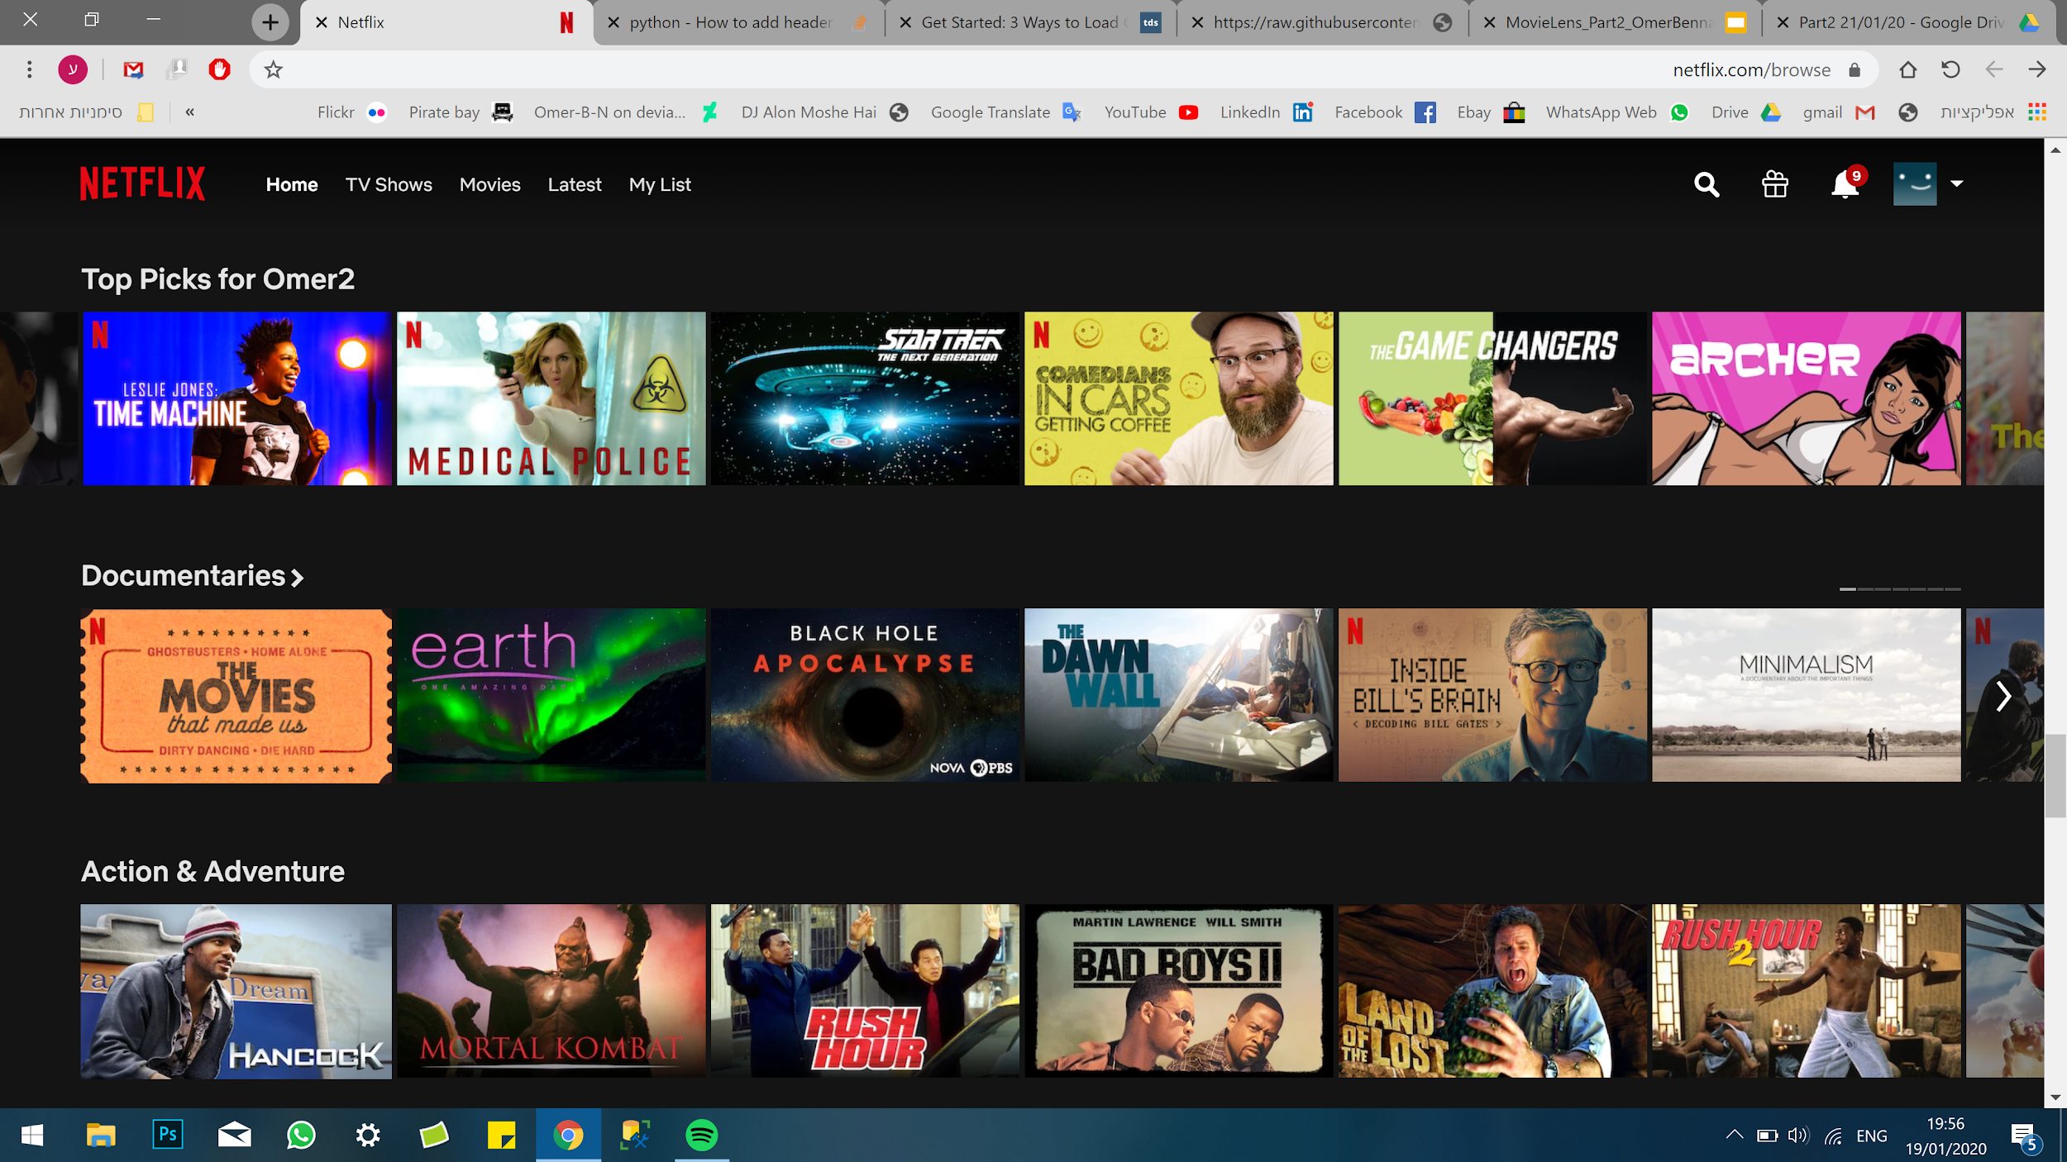
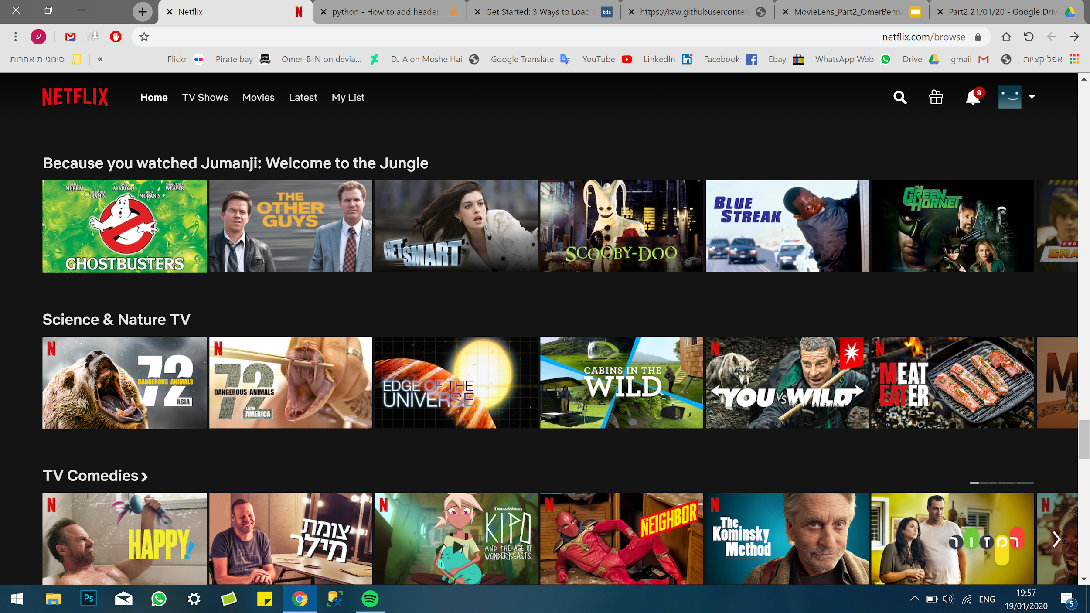
Collaboration vs. content based recommender
Collaborative picks
Picks by content

Slide 23


Content Filtering (1)
IMDB Metadata Extraction
Production Company
Top 5 Actors
Director/s
Writer/s
Producer/s
Composer/s

Slide 24
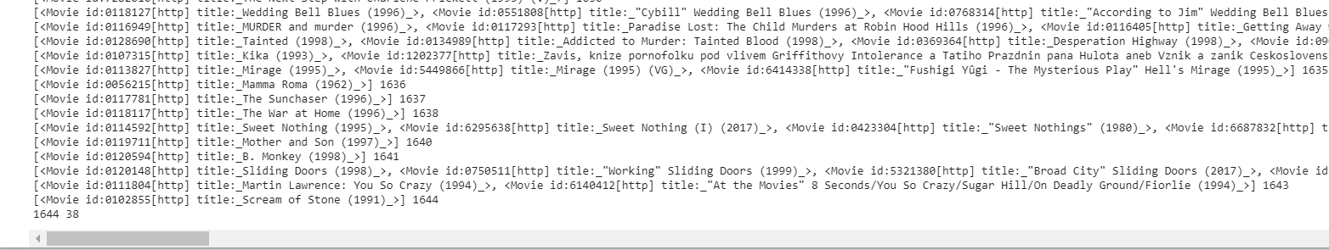
Content Filtering (2)
IMDB Metadata Results Processing
1644 movies (of 1682) were found
Extensive processing needed…

Slide 25
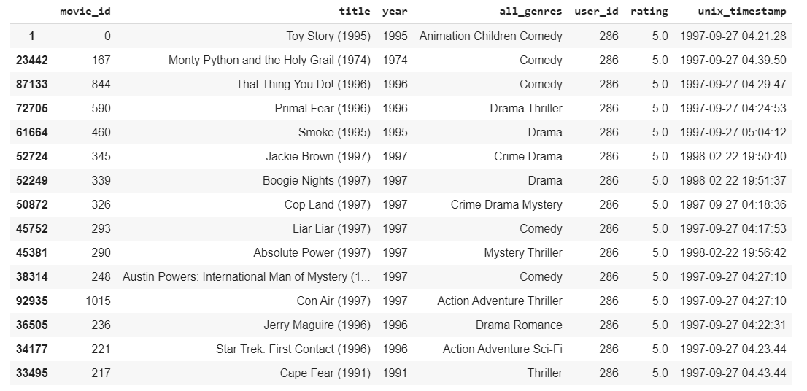
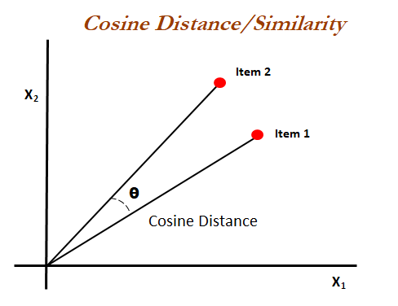
Content Filtering (3)
Implementation via Cosine Similarity
Step #1 – Identifying User’s Top Preferences
Step #2 – Identifying similar movies via Cosine Similarity

Slide 26
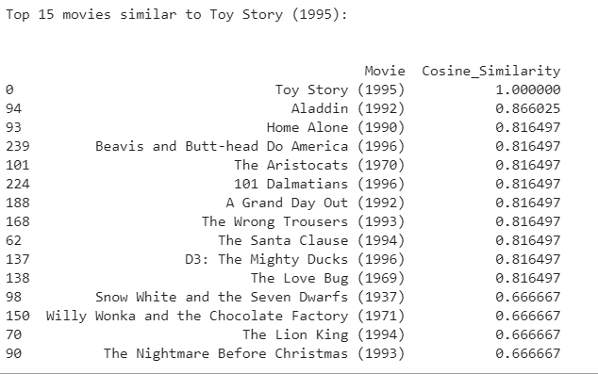
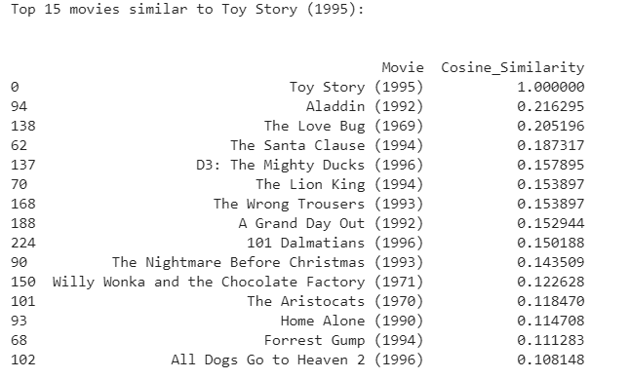
Content Filtering (4) – 15 of 241 movies
By Genre
By Metadata

Slide 27
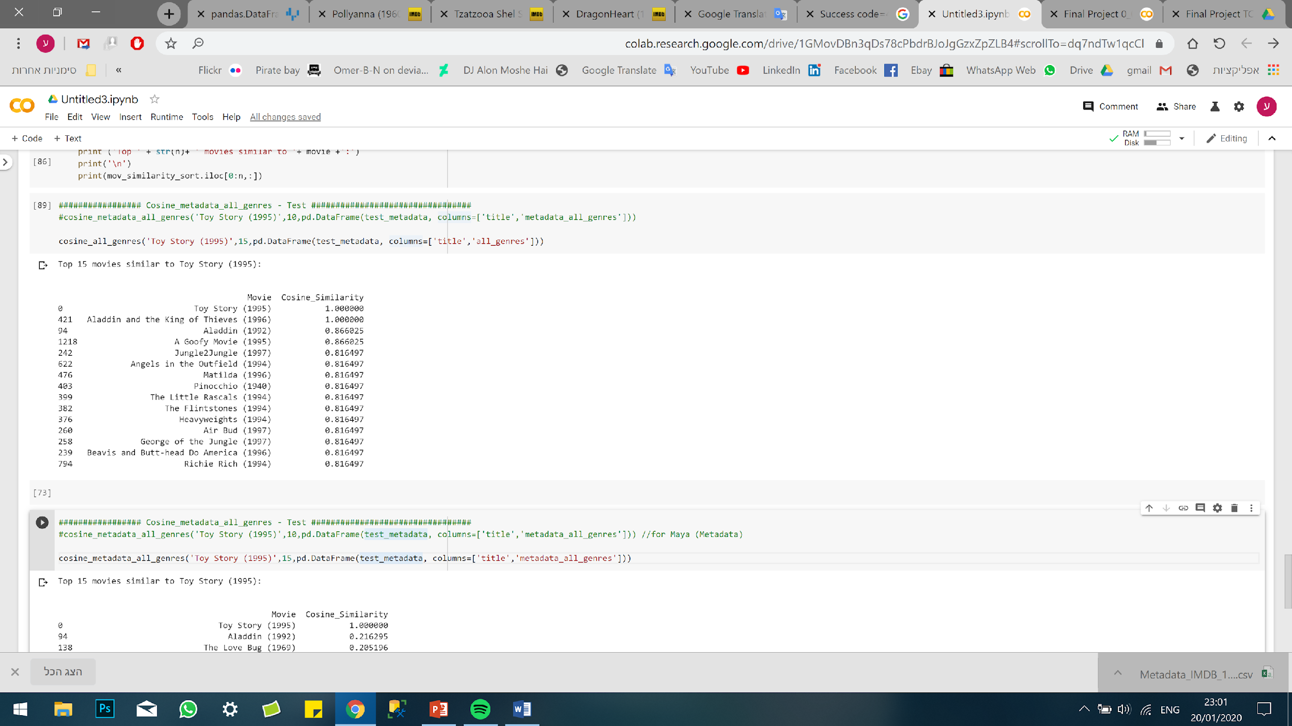
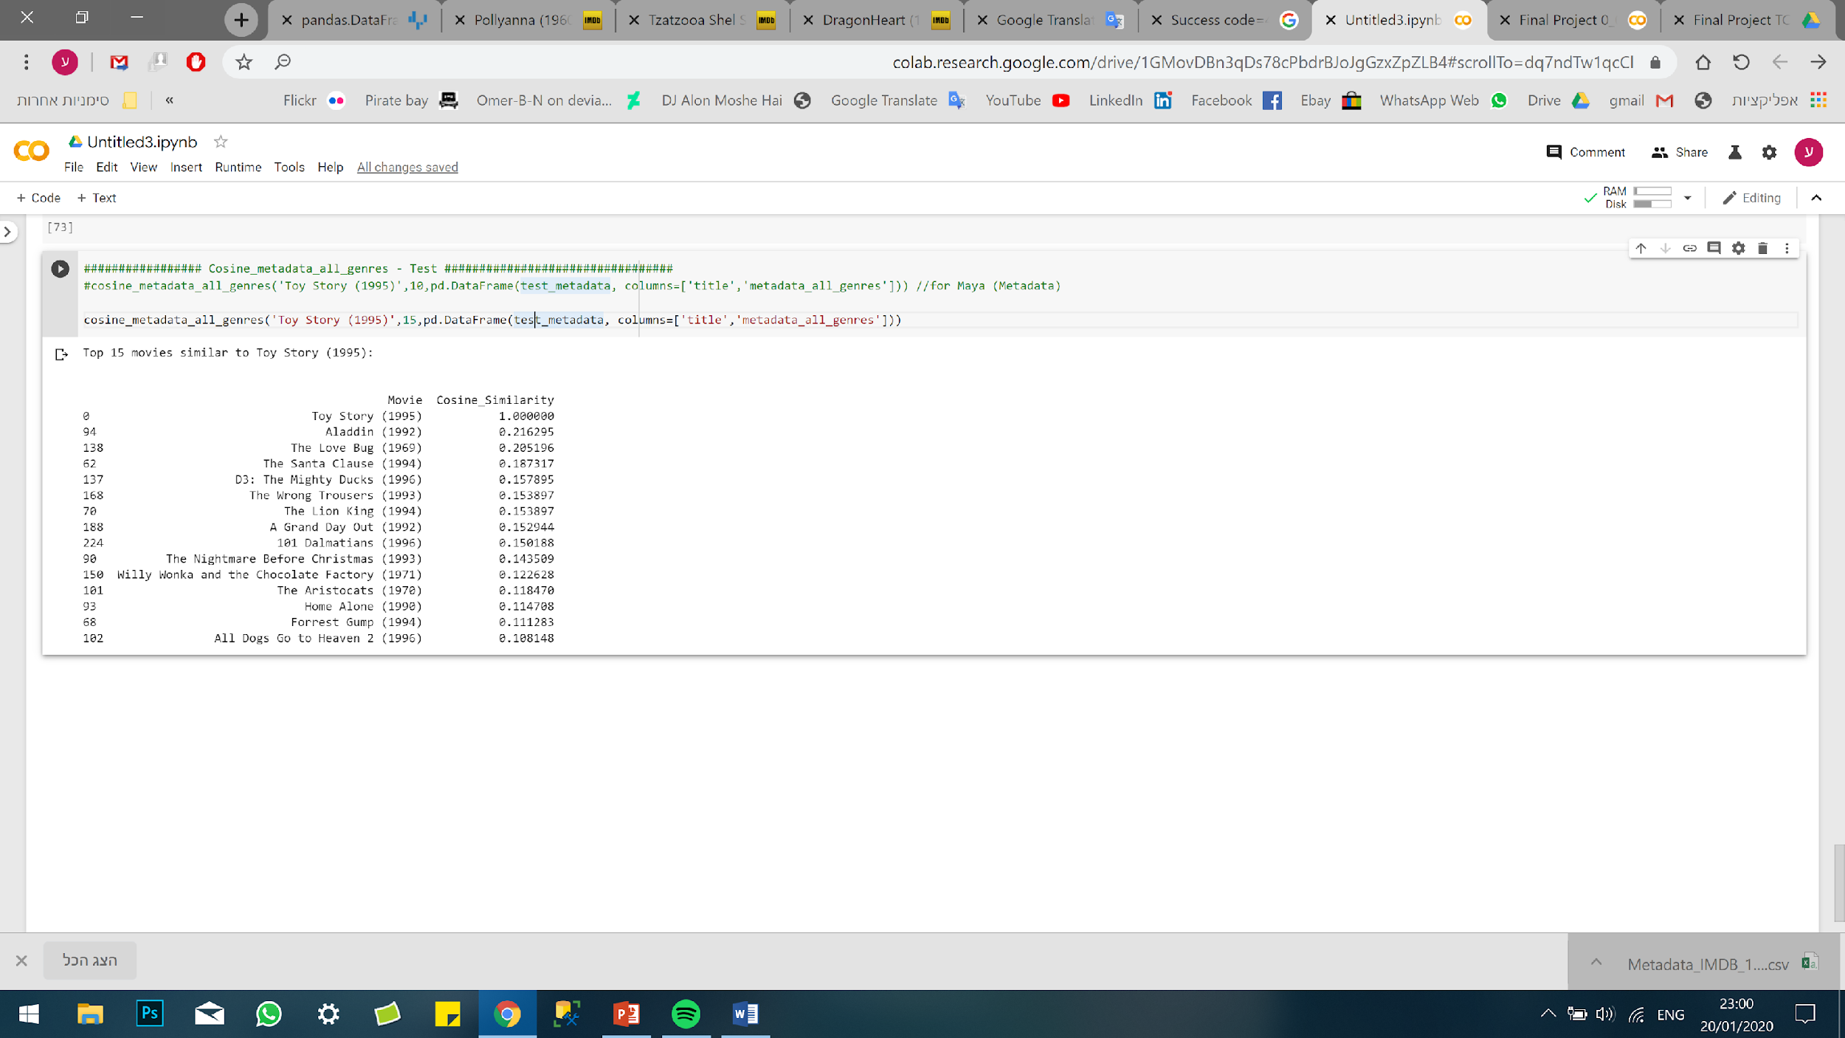
Content Filtering (5) – 15 of 1,682 movies
By Genre
By Metadata

Slide 28
Model Limitation & Mitigations
Notes:
OMER

Slide 29
Recommendation Model Limitations (1) Limits & Weaknesses
High Variance of Data (diverse movies / users / ratings)
Unbalanced Data (‘Popular Items’ vs. ‘Niche’)
Absence of ‘Ground Truth’ (cases of no ‘Actual’ User-Rating)
New Users / Movies (very few data)
‘Eccentric’ Movies (extremely liked by certain users and extremely disliked by others)
Equivocal Definition of Thresholds for ‘Valuable’ Data
Absence of ‘Holistic Evaluation Scenario’

Slide 30
Recommendation Model Limitations (2) Mitigations
‘Cross Validation’ in Model Selection process (‘training’ based on all movies)
Careful Selection of ‘Valuable’ Data (to achieve high-quality results)
‘Risk Distribution’ (to mitigate ‘Bias’):
Using Several Paradigms of Recommendation Systems (collaborative, Content)
Using Several Models
(Basic Algorithms, K-NN inspired, Matrix Factorization-based, Slope One, Co-Clustering)
Using Several Datasets per Model (Ratings>=1,>=5, ,>=20 ,>=50 >=100)
Using Several Performance Measures (RMSE, MAE, ‘Hit-Rate’)

Slide 31
Conclusion &
Future Work
Notes:
OMER

Slide 32
Conclusions
Data Relationship Understanding for Pre-processing (Movies ⬄ Ratings ⬄ Users)
‘Collaborative Filtering’ ‘Valuable Data’ Trade-Off Data Integrity vs. ‘Long-Tail’ Leverage
'Content Based’ Recommendations – the 'right content' is crucial for obtaining the 'right items'
‘Risk Distribution’ for ‘Bias’ Mitigation
Using inputs from various models - recommendation system paradigms / models / datasets
‘Recommendation Systems’ produce best results for ‘Mainstream’ users / items (non-eccentric)
Best Model for ‘MovieLens’ dataset: KNNBaseline | CV=10
Performance Measures: ‘RMSE’: 0.93 ; ‘MAE’: 0.73 ; ‘Hit Rate’: 0.6

Slide 33
Recommendations for Future Work
Advanced Content Filtering (e.g. ‘Storyline’ Text Mining)
Demographic (Segmentation) based Recommendations System (for new users)
‘Hybrid’ Recommendation Models (e.g. ‘Content’ + ‘Collaborative’)
Advanced User-Labeling & Movie Segmentation (Providing ‘Top’ recommendations for each User-Label)
Methods & Techniques:
T-SNE (t-distributed stochastic neighbor embedding) / Unsupervised Learning
A dimensionality reduction technique suited for visualizing high-dimensional data in a low-dimensional space
GNN (Graph Neural Networks) / Semi-Supervised Learning
Directed Graph containing embedded information (e.g. regarding relationships)

Slide 34

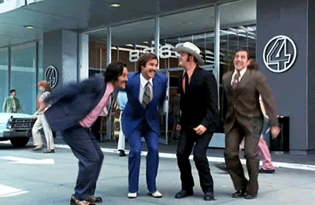
Thank You

